Slide 1
How to consistently measure Blood Pressure
Marko Suchy

Slide 2
Choosing a subject
Make sure subjects:
Are not in a rush to get anywhere, or otherwise mentally distracted
“Mental distraction and mental stress led to …increases in HR during distraction and in systolic BP during stress. ”
Represent a reasonably random sample
Ask friends from different groups, at different times, etc..
Have not just finished exercising!
“We found a postexercise reduction in mean arterial pressure”
Are normotensive:
Ask: “Do you have normal blood pressure?”
In many studies, Normotensive and hypertensive patients reacted differently to treatments.

Slide 3
Preparing a subject
Prepare a relaxing environment! It should be free of distractions, loud noises, bright lights, etc..
Have a subject just sit and relax for 3 minutes.
During these 3 minutes, avoid introducing stress!
To do so, we will give them a relatively boring magazine to look at, and not allow them to use their phone.
Tell them this is a non-invasive study, and will take just 5 minutes (which is true.)

Slide 4
Measuring a Subject’s BP
Make sure a subjects legs are uncrossed!
“Normotensive participants showed a smaller, though significant, increase of systolic blood pressure 2.7 (1.2–4.2) mmHg”
Just before measuring BP, say “Take a couple breaths and relax” both before and after the video
Do not allow the participant to see the BP measurement!
Do not talk while taking blood pressure.
“Blood pressure increased significantly (p < .01) under both talking conditions.”

Slide 5
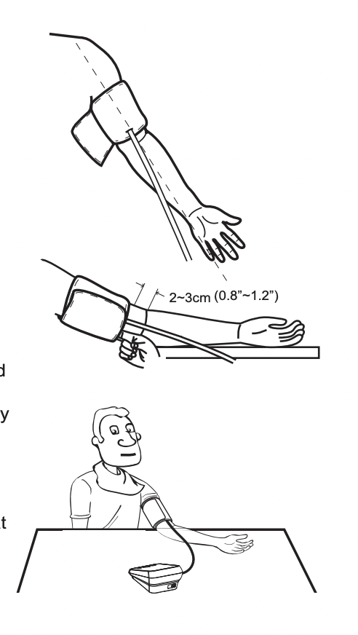
Measuring a Subject’s BP continued
Properly line up Artery mark with the Brachial Artery,
2 – 3 cm above elbow
Tie the cuff snug, but not too tight
Sit subject comfortably, with arm resting flat
Roughly align air hose with arm
See the Lovia User Manual for more details.

